Slide 1
GROUP B: Chat App API Design
Members:
Swamy Reddi (team lead)
Frank Feng (tech lead)
Nicole Du (doc lead)
Anand Gadsing (dev)
Daniel Kuo (dev)

Slide 2
BigFoot’s ChatApp
Introduction:
The design pattern behind Development

Slide 3
GUI Demo
Talk order: by the use case
register, join room, create room, send message, send hate speech, leave room, logout, login

Slide 4
Overview of the backend structure
UML diagram overview
Illustrate how data flow with two user cases (send message & create room)

Slide 5
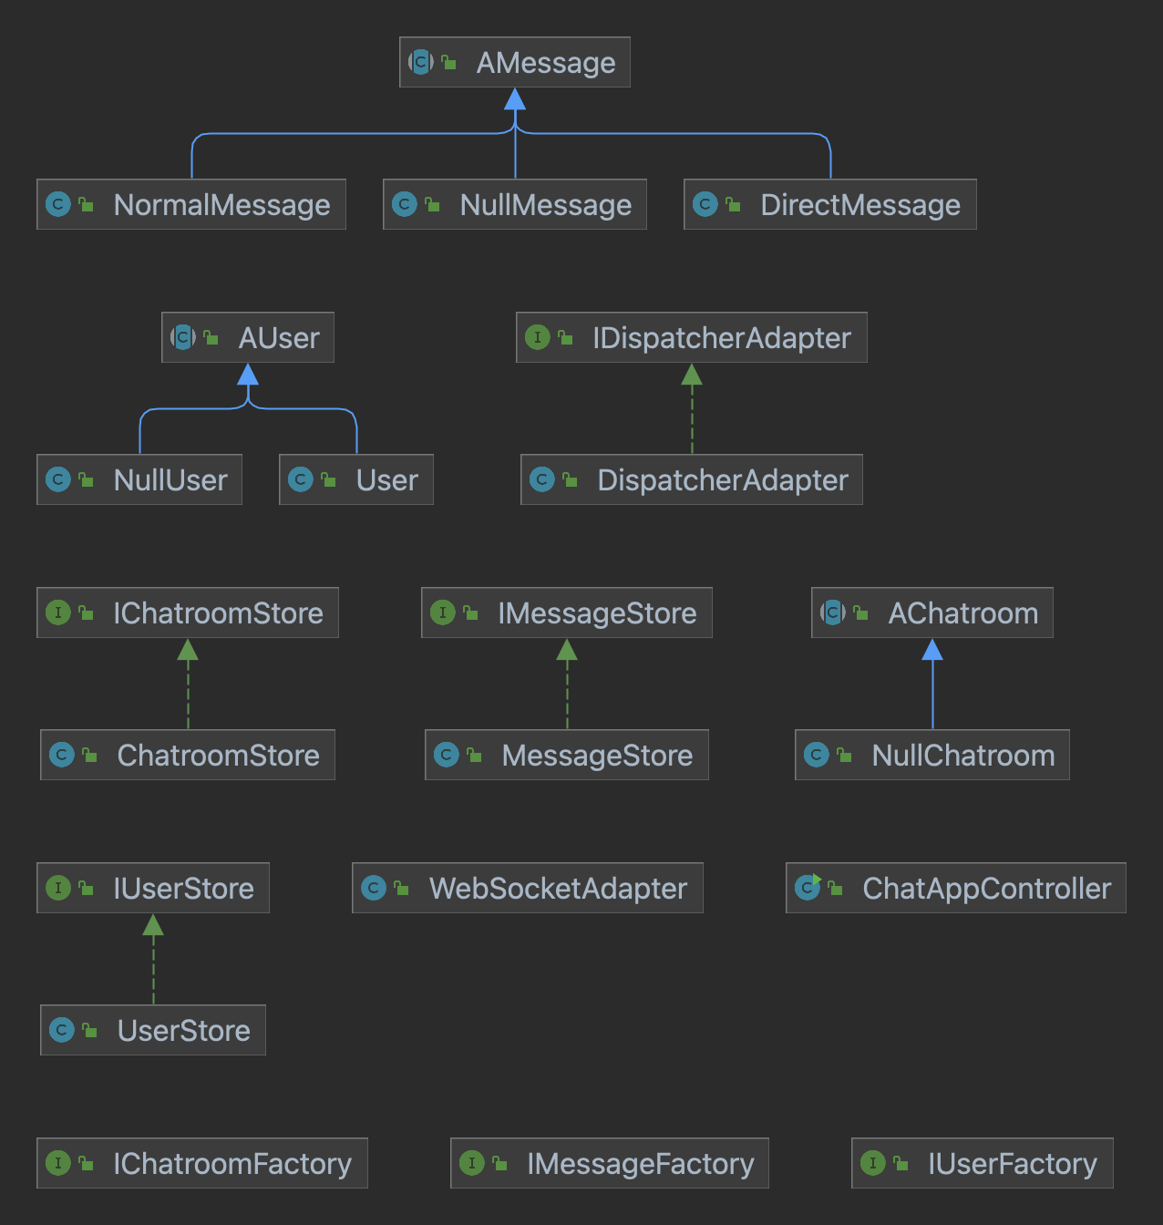
UML Diagram

Slide 6
Illustration of the data flow with user case
Send message

Slide 7
Illustration of the data flow with user case
Create Room
join the chat room
leave the chat room
switch the chat room

Slide 8
Divide by user, chat room, message
Abstract classes, interface
List of abstract classes, interface
Usage of each one
Message store
User store
Chatroom store

Slide 9
Illustration of the data flow with user case
Registration & Login & Logout
Notes:
nicole

Slide 10
Design Pattern
Null object design pattern: message, classroom
Factory design pattern: user, chat room, message
Singleton design pattern: Each store object, use make and only
Notes:
nicole

Slide 11
Next we will do …
conclusion

